Slide 1
Syllabus updated

Slide 2
How to succeed
Attend lectures and take notes in your own words
2) Study lecture slides before each quiz
3) Make illustrated study guides before each exam
4) ASK QUESTIONS

Slide 3
How to ask questions
Interrupt me/raise your hand
Canvas discussion board
Email me

Slide 4

Important Policies
Attendance and participation
Late Assignments
Grade disputes – before final
Academic integrity
I have high expectations for you! I fully expect you to put forth your best effort.

Slide 5
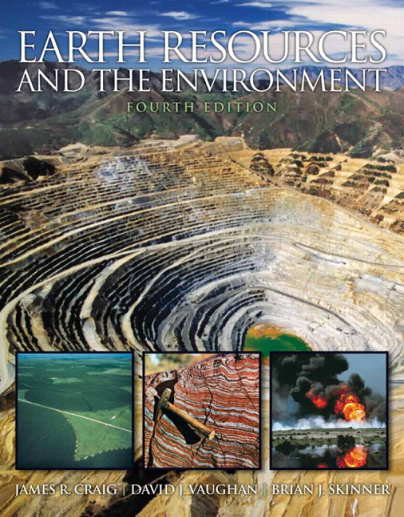
Textbook
Earth Resources and the Environment
RECOMMENDED, not required
Today’s reading:
Part 1 – Introduction
pp. 1-4

Slide 6
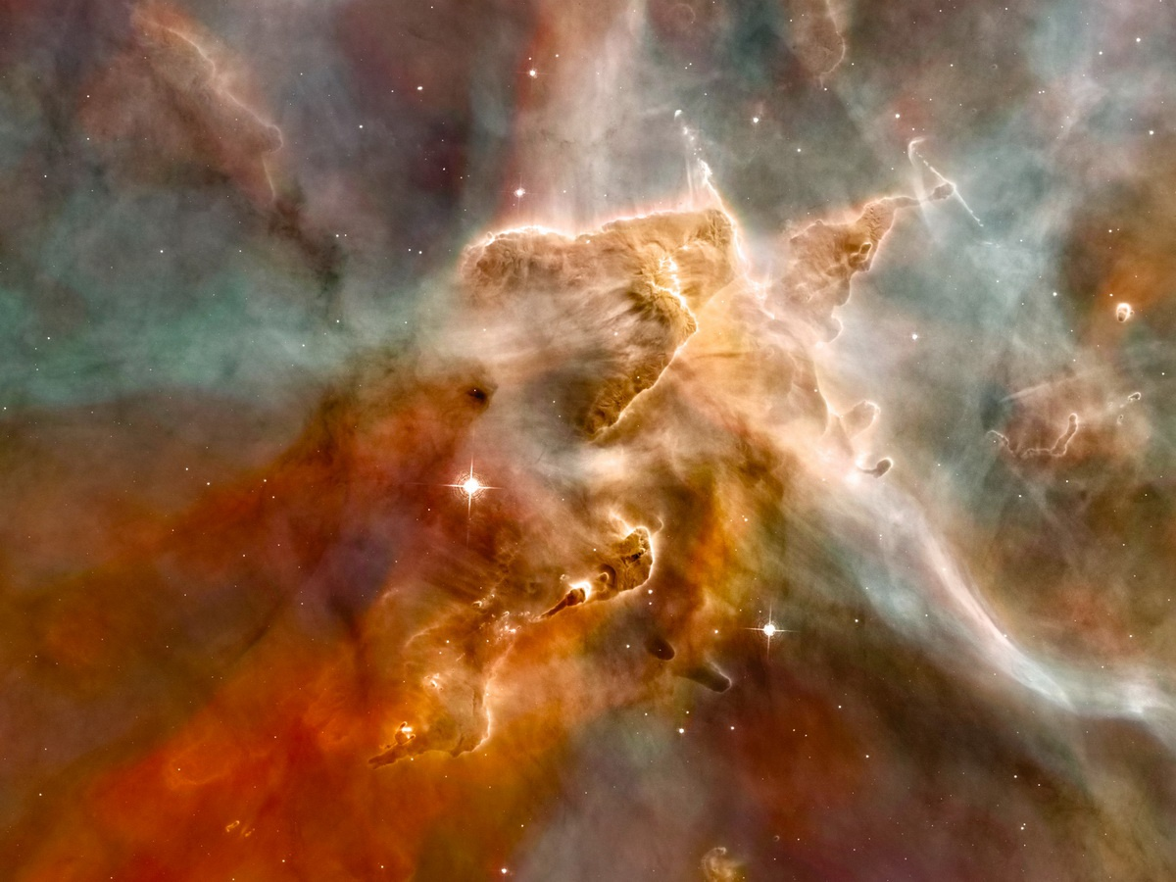
The Elements:
Where did they come from?
Notes:
A study of earth resources is ultimately a study of chemistry – we recover valuable elements that exist in the earth and are concentrated in some location by a geologic process – but how did those elements come to be in the earth to begin with? We will start this course with a discussion of the origins of matter, our universe, and the earth

Slide 7

Meeting time…
Get with you 2 pm meeting buddy
Brainstorm all of the economically useful elements you can think of
Notes:
Common metals, fertilizer elements, rare metals, base metals

Slide 8
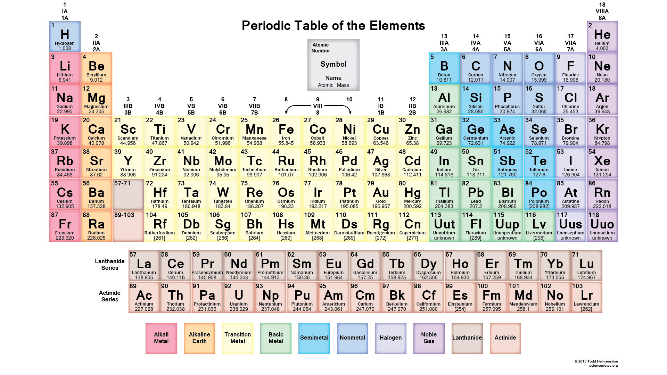
Notes:
How do we read a periodic table? Where is mass written? Atomic number? How is the table organized?
Talk about their different masses (take Fe as an arbitrary divider (see why in a moment) how many have a mass less than Iron?)

Slide 9
Meeting time…
Get with you 2 pm meeting buddy
Choose an item in this room – what is the history of the elements that make up this item? Take it WAAYYYY back
Notes:
Take it back as far as you can – be creative – I just want to see what you guys come up with. Tell the story of how that item was made

Slide 10
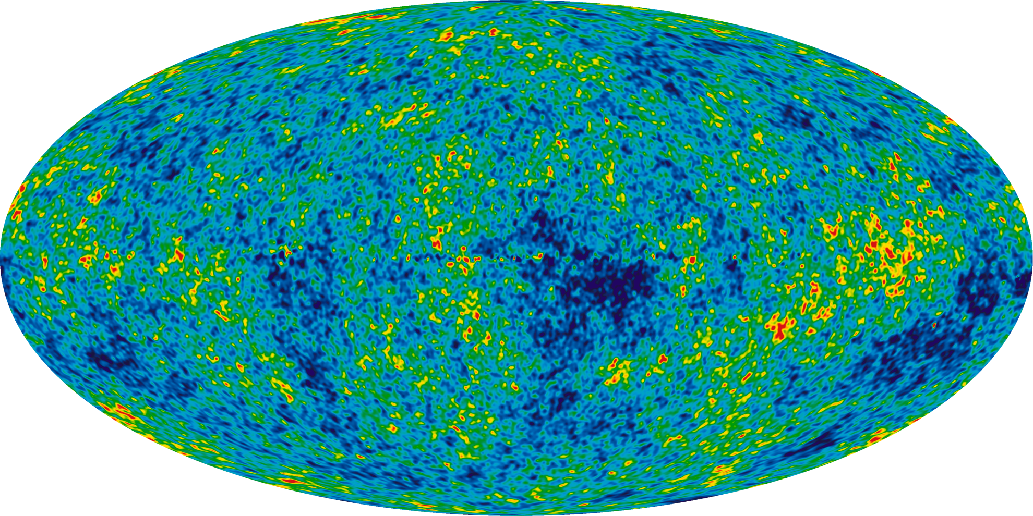
The Universe began with the Big Bang at 13.8 Ga
Notes:
This is a picture of Cosmic Microwave Background: the oldest light in the Universe, that we can detect as a background radiation using communications antenna

Slide 11
ka = thousands of years ago (“kilo-annum”)
Ma = millions of years ago (“mega-annum”)
Ga = billions of years ago (“giga-annum”)
NB: These refer to the number of years before present;
don’t say something like “Ma ago”

Slide 12
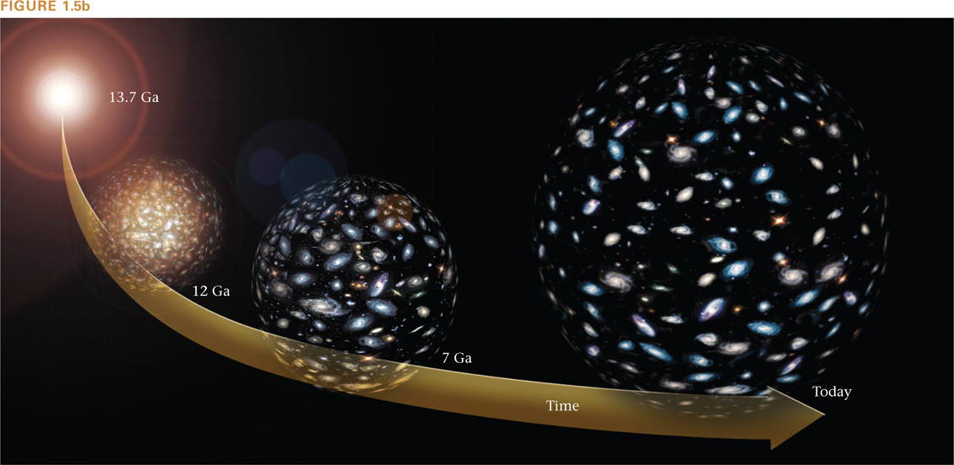
The Big Bang
At first there was only energy…
Within a few seconds: protons, neutrons, and electrons formed H
3 minutes: nuclear reactions fused H to form He atoms → 98% of all matter
Gravity brought these atoms together to make galaxies and stars that
clung together in an expanding universe

Slide 13
After the Big Bang… How were all these elements we just discussed formed?
Notes:
Write 3 types of nucleosynthesis on the board –
Big Bang
Stellar
Supernova

Slide 14
Three types of nucleosynthesis
Big Bang NS
Stellar NS
Supernova NS

Slide 15
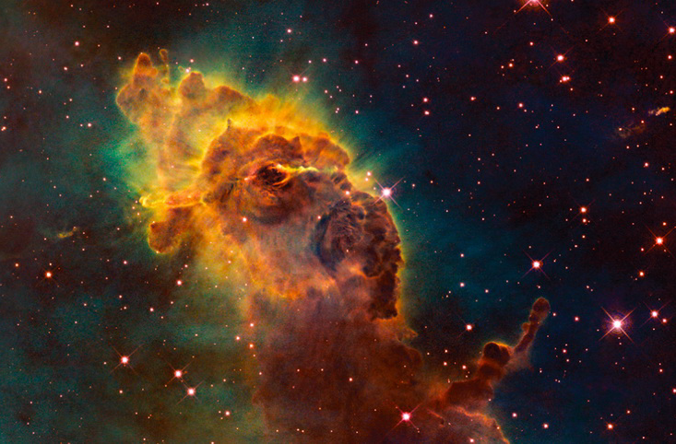
Big Bang nucleosynthesis
In the first minutes of the big bang: H, He, (and trace amounts of other light elements)
Nebulae – giant space clouds of gas and dust
Notes:
The Big Bang nucleosynthesis formed H, He, Li, Be, B in the first 3 minutes of the universe’s existence.
Universe cooled, atoms formed molecules, they accumulated into patchy clouds called nebulae
In the very beginning of the universe, all Nebulae were 75% H and 25% He
Where did the rest of the elements come from? →STARS

Slide 16
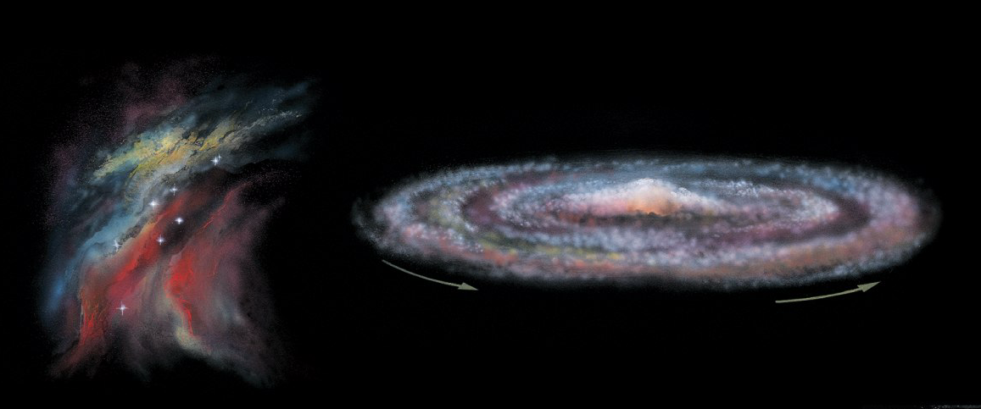
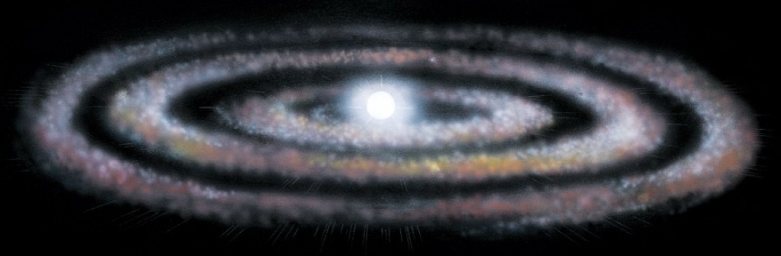
Birth of the first stars
Gravity pulls together material to make new stars and a surrounding accretionary disk
Center gets DENSE and HOT
→ fusion reactions begin
Notes:
Stars formed by gravity. Larger nebulae had larger mass, exerting larger gravitational pull, sucking in surrounding matter.
As the dense region grew denser it started spinning, gravity collapse inner portion into dense ball. Denser = hotter. When it reaches 10 million degrees, H nuclei slam into each other so forcefully, they fuse. NUCLEAR FUSION

Slide 17
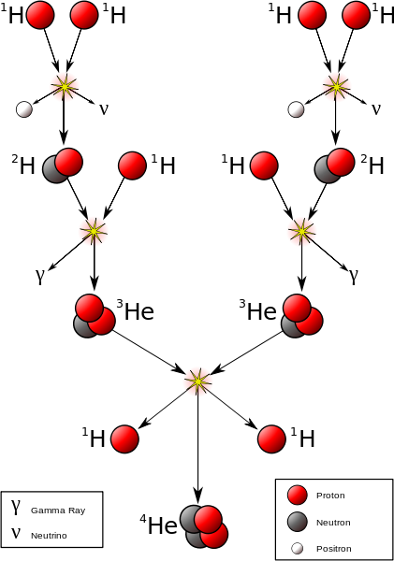
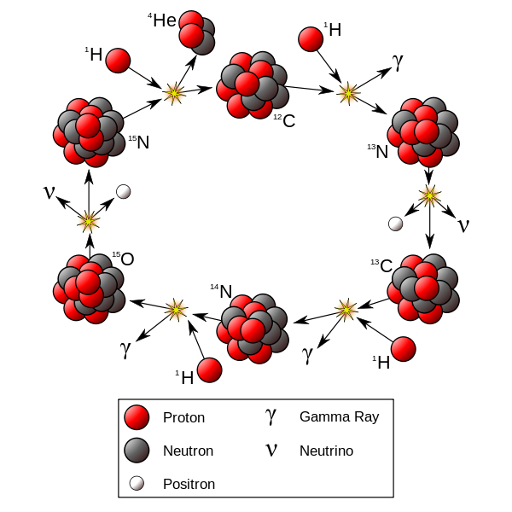
Nuclear fusion: stellar nucleosynthesis
Four ¹H combine to form one ⁴He
BUT!!! 4H – 1He = 0.03 amu
Mass difference is converted to energy [E = mc²]
Nuclear fusion creates A LOT of energy
powers stars and makes moderately heavy elements (up to Fe)
Notes:
Stars formed by gravity. Larger nebulae had larger mass, exerting larger gravitational pull, sucking in surrounding matter.
As the dense region grew denser it started spinning, gravity collapse inner portion into dense ball. Denser = hotter. When it reaches 10 million degrees, H nuclei slam into each other so forcefully, they fuse. NUCLEAR FUSION

Slide 18
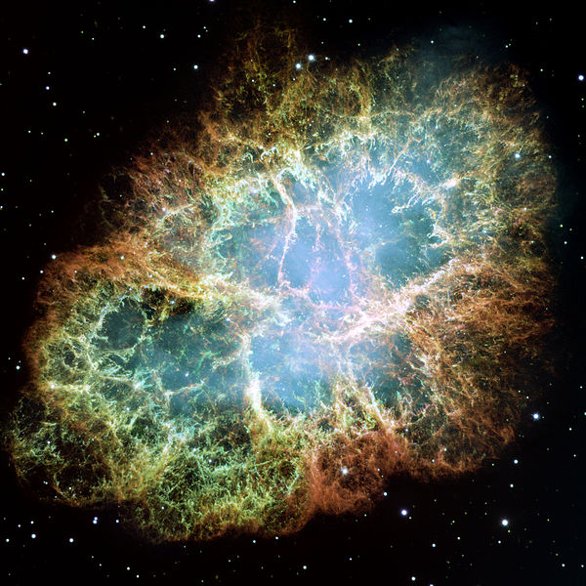
Supernovae nucleosynthesis
Old stars explode in supernovae explosions and release their elements into the galaxy
The heaviest elements are made during supernovae (Heavier than Fe)
Crab Nebula (from supernova in 1054)
Notes:
First generation stars didn’t live long – they burn hotter and run out of fuel faster, surviving only a few million years
When a star dies, it makes a giant explosion called a supernova. This blasts the star’s matter back into space.
Most of the atoms heavier than Fe are formed during the actual supernova explosion.

Slide 19
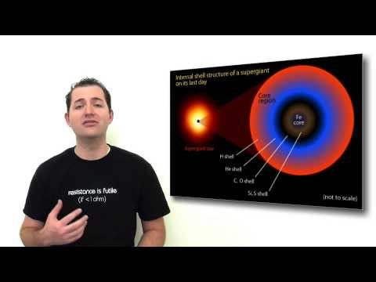

Slide 20
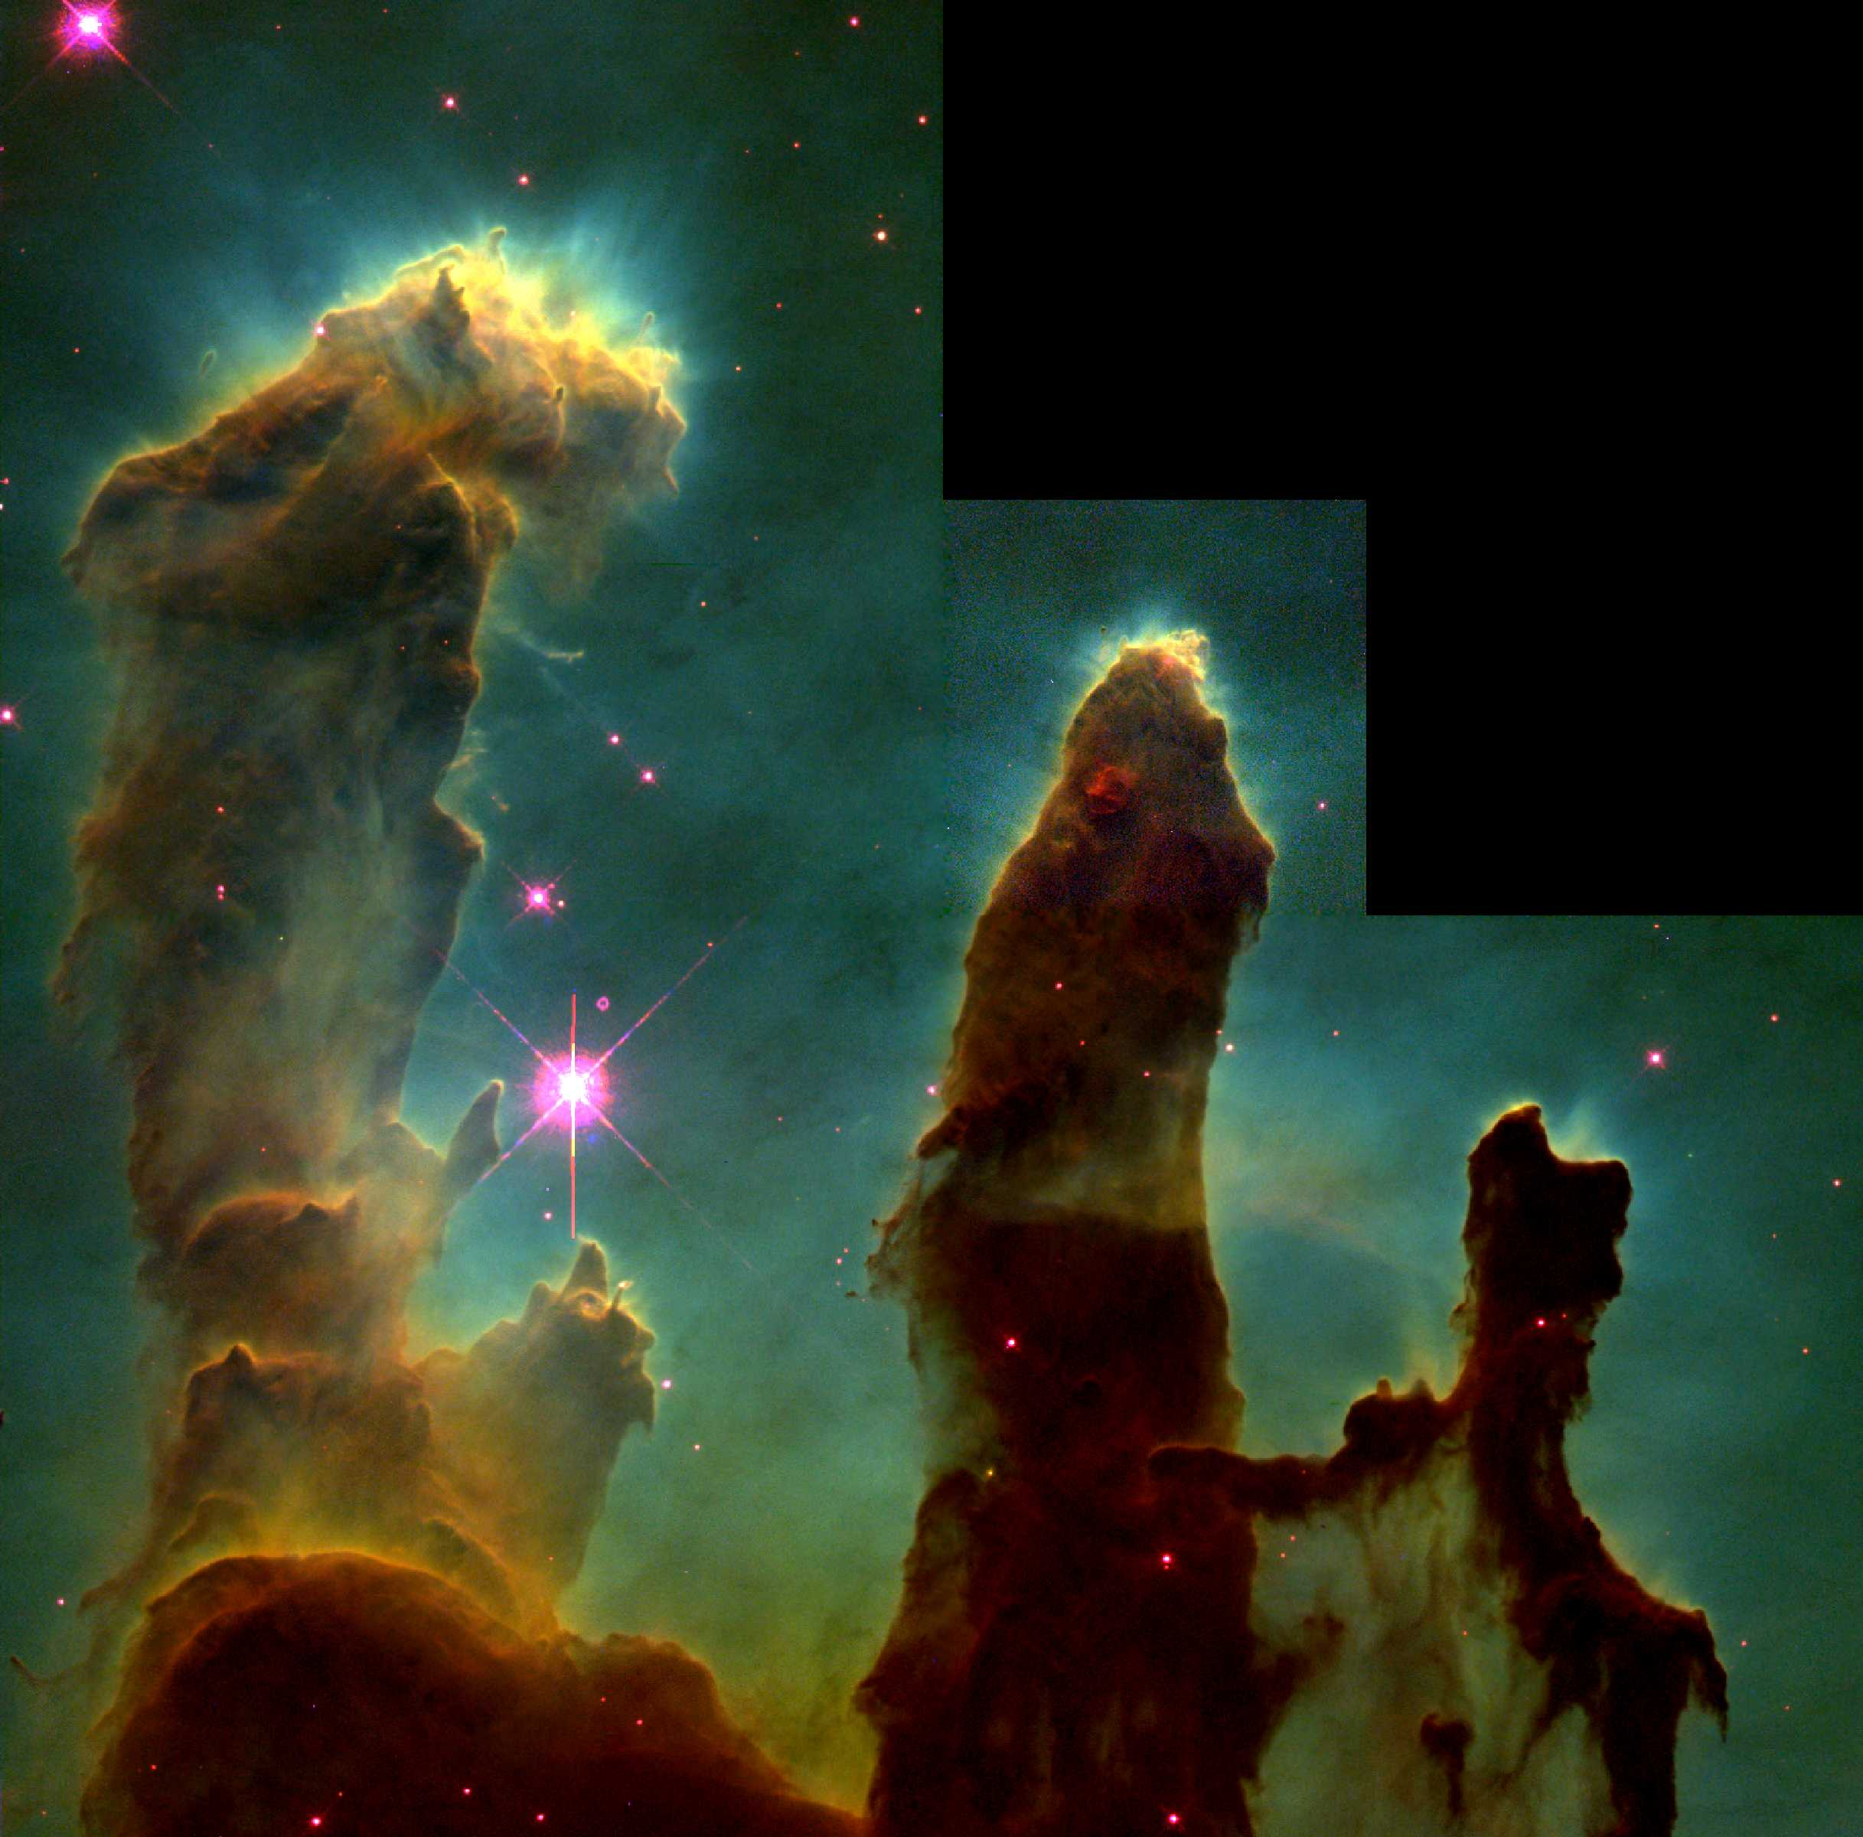
Material/elements released by supernovae will then become incorporated into new nebulae
The cycle repeats!!
Eagle Nebula—pillars of interstellar gas
Illuminated by young stars
Notes:
What does this new nebulae now contain? --- Succeeding generations contain a greater proportion of heavier elements.
The mixture of elements we find on earth includes relicts of Big Bang nucleosynthesis as well as the guts of dead stars.
The elements that make up your body were created in a star!

Slide 21
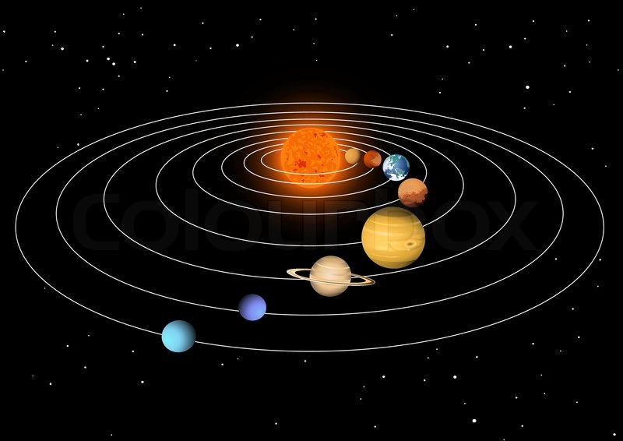
Our nebula was at least a 3rd or 4th generation feature!
Notes:
Stars formed by gravity. Larger nebulae had larger mass, exerting larger gravitational pull, sucking in surrounding matter.
As the dense region grew denser it started spinning, gravity collapse inner portion into dense ball. Denser = hotter. When it reaches 10 million degrees, H nuclei slam into each other so forcefully, they fuse. NUCLEAR FUSION

Slide 22
With 2 pm partner
Where did the elements in your item first form?
Big Bang?
In a star?
In and supernova explosion?

Slide 23
Summary
Elements are created in three ways
Big Bang nucleosynthesis → H, He
Stellar nucleosynthesis → Elements up to Fe (via fusion)
Supernova nucleosynthesis → Elements heavier than Fe
Cycle repeats - New nebula incorporate material sent out into space from older supernova explosions (Heavy elements)

